Slide 1
Attention Training
Jeffrey Yuan and Harvey Wang

Slide 2
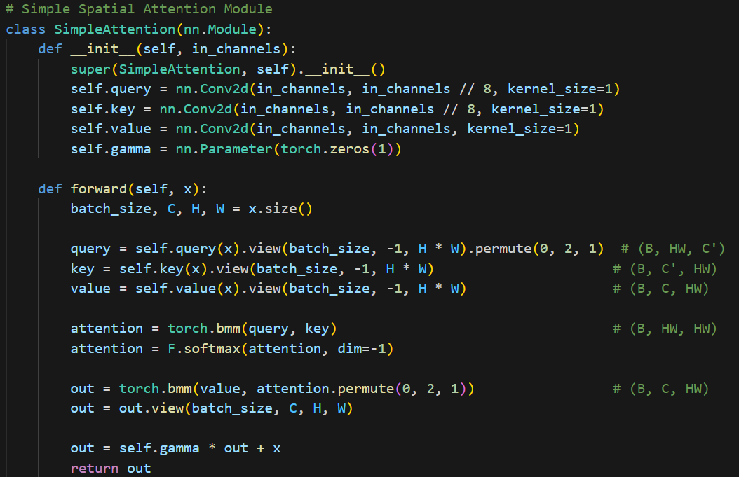
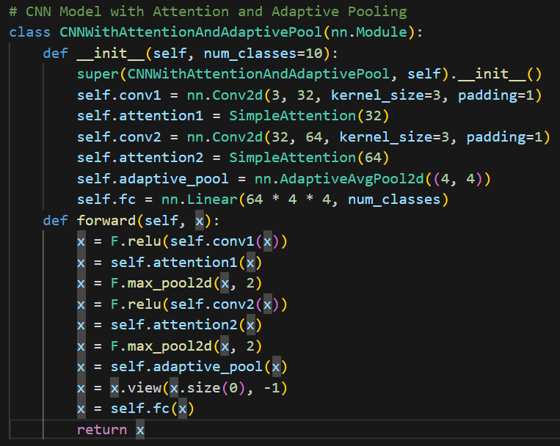
Simple Example of a CNN with Attention

Slide 3
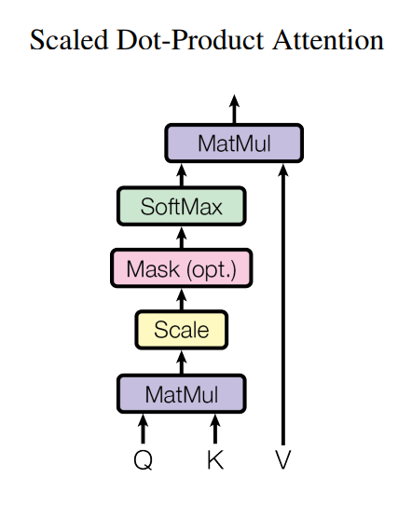
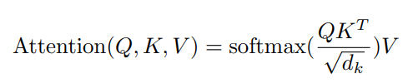
Map a query and a set of key-value pairs to an output
Q: Matrix of queries
K: Matrix of Keys
V: Matrix of Values
d_{k}: Dimension of queries and keys
d_{v}: Dimension of values

Slide 4
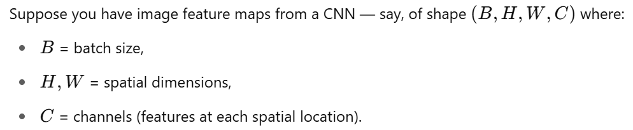
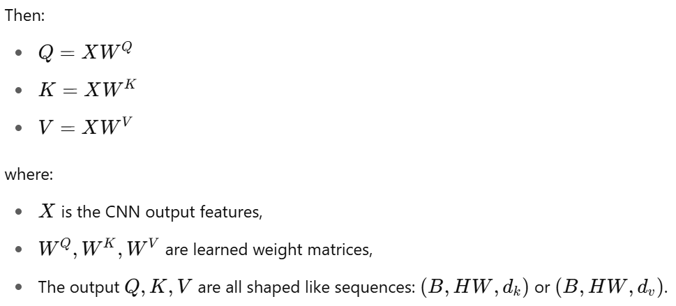
Specifically for images with CNNs:

Slide 5
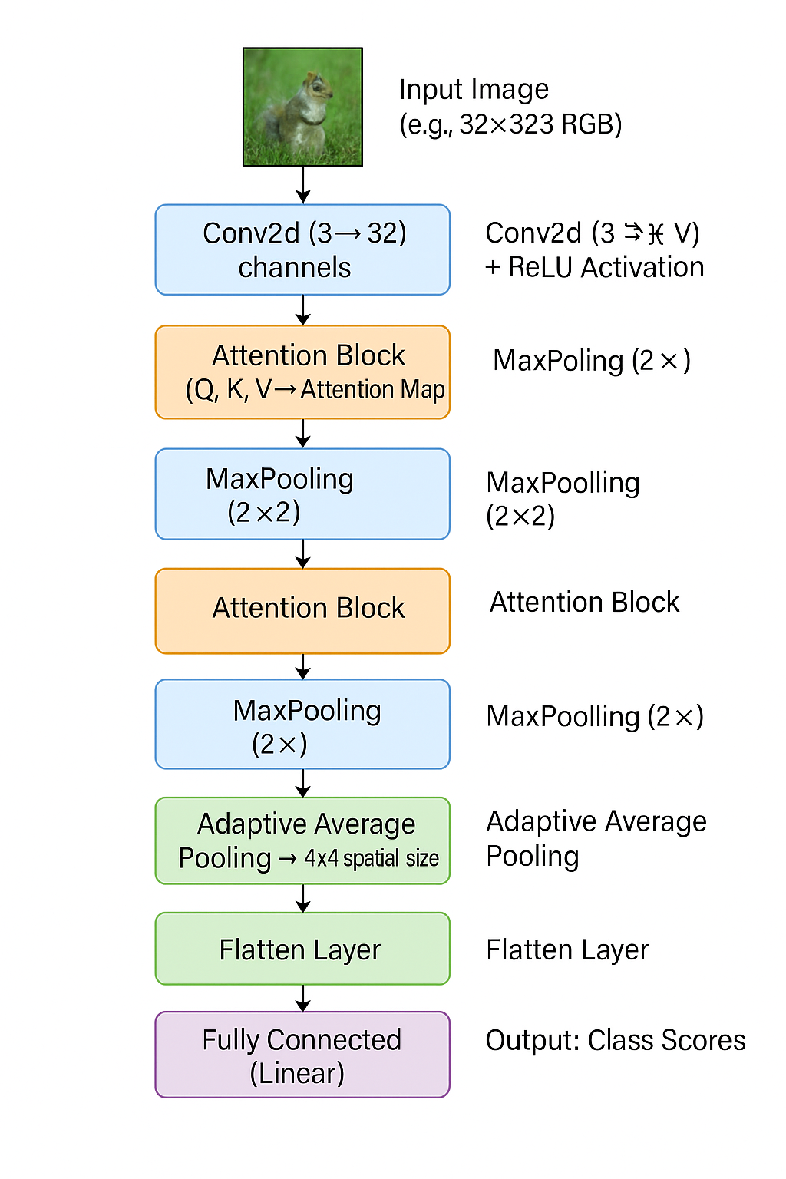
Input Feature Map
↓
Linear Projection
┌─────┬─────┬─────┐
│ Q │ K │ V │ (Query, Key, Value)
└─────┴─────┴─────┘
↓
Compute Similarity
(Matrix Multiplication)
Q × Kᵀ
↓
Scale and Normalize
(Divide by √dk, then Softmax)
↓
Attention Map
↓
Weighted Sum
(Attention Map × V)
↓
Output Feature Map

Slide 6
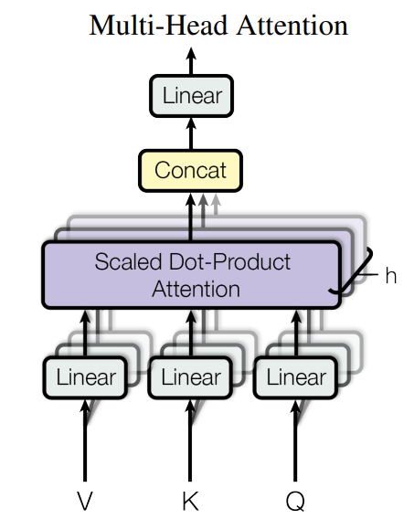
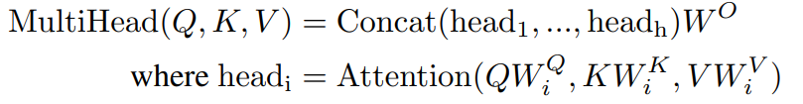
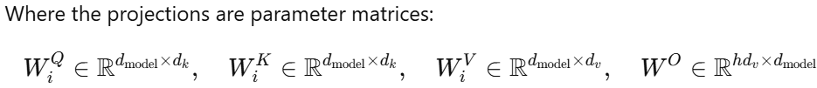
Instead of a single attention function with d_{model}-dimensional K, V and Q,
Linearly project the Q, K and V h times with different, learned linear projections to d_{k}, d_{k} and d_{v}
Yield d_{v}-dimensional output values
Concatenated and projected, resulting in the final values
Allows the model to jointly attend to information from different representation subspaces at different positions.

Slide 7
Applying Attention to ResNet50

Slide 8
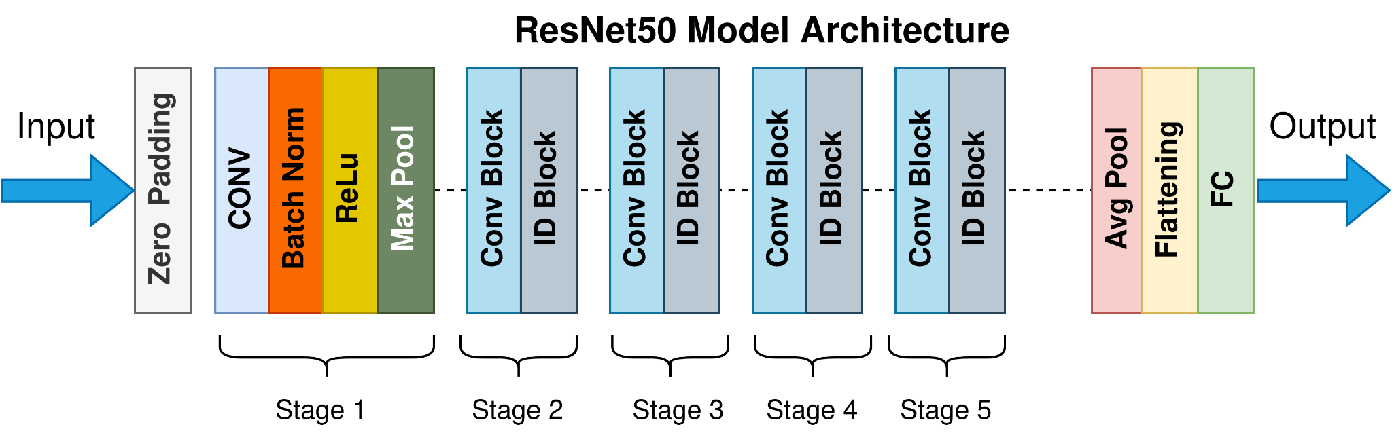
Insert SimpleAttention layers after conv. blocks

Slide 9
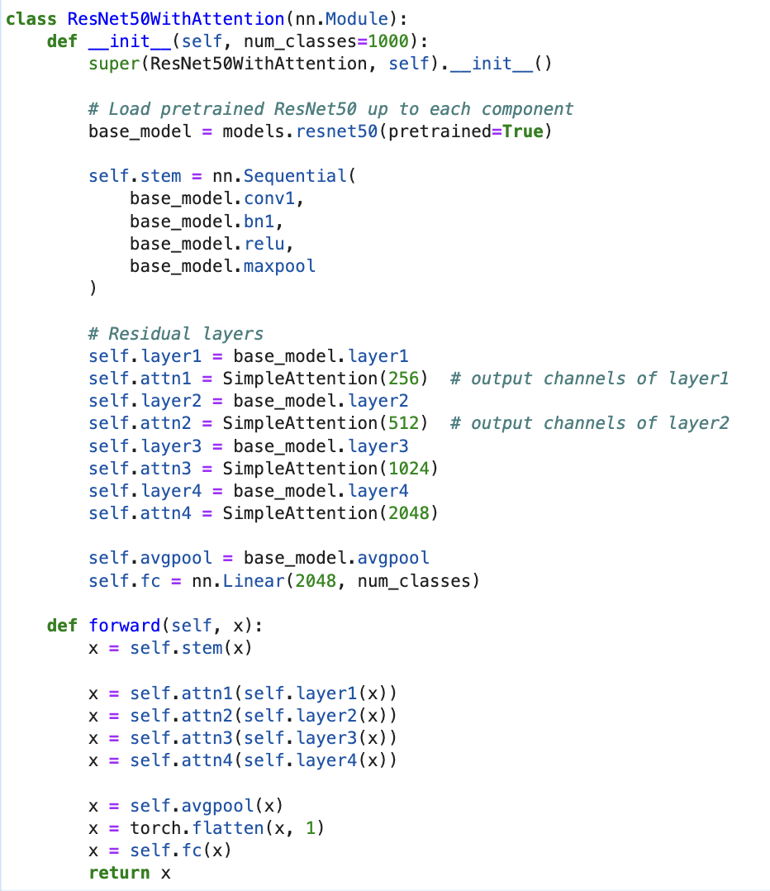

Slide 10
Possible alternative:
Early layers capture low-level features (edges, textures)
Deeper layers capture higher-level semantics (shapes, objects)
Attention mechanisms work best when they can weigh important semantic regions — which become clearer deeper in the network
So, adding attention later helps focus on where to look when more abstract features are available
Insert SimpleAttention layers only after later conv. blocks

Slide 11
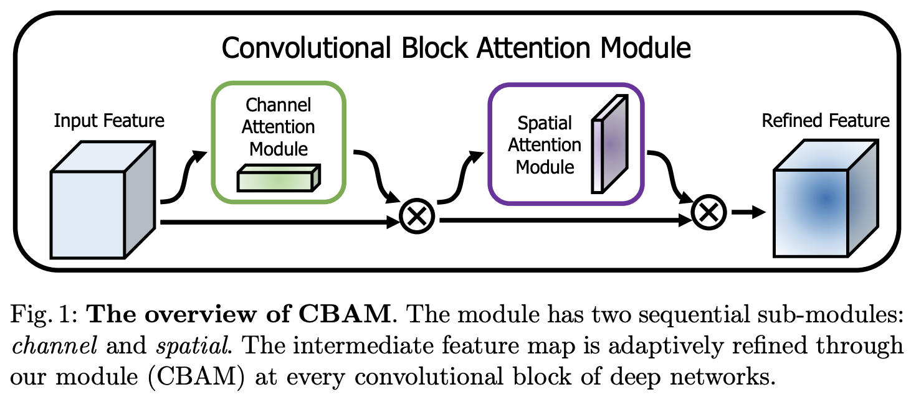
Beyond Scaled Dot-Product Attention: CBAM

Slide 12
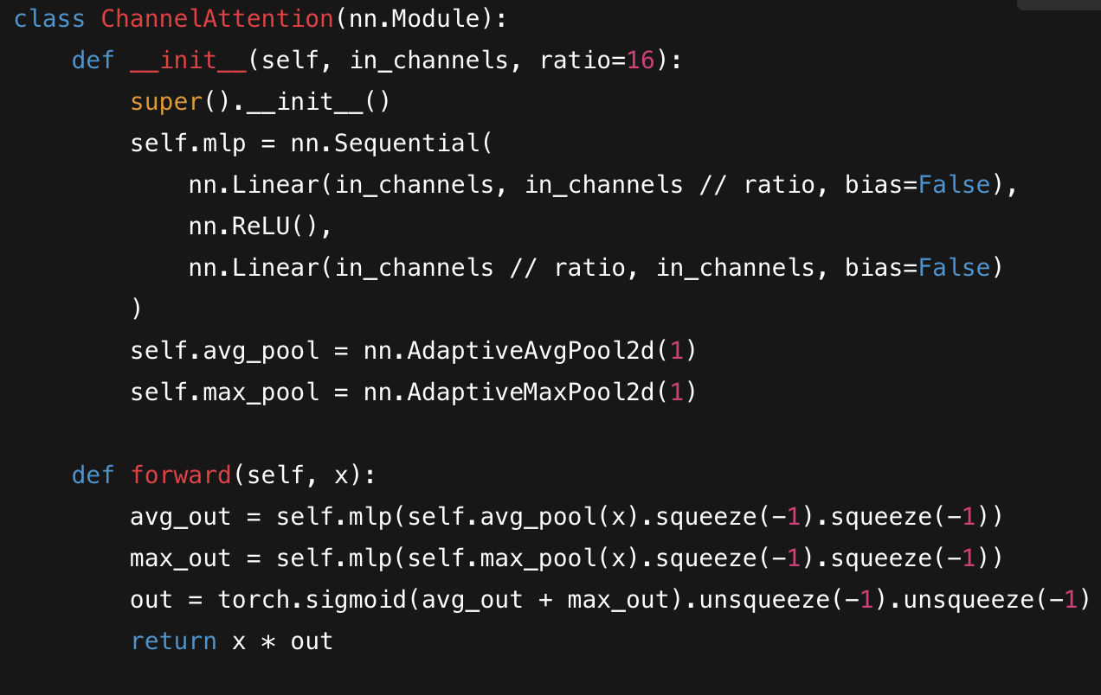
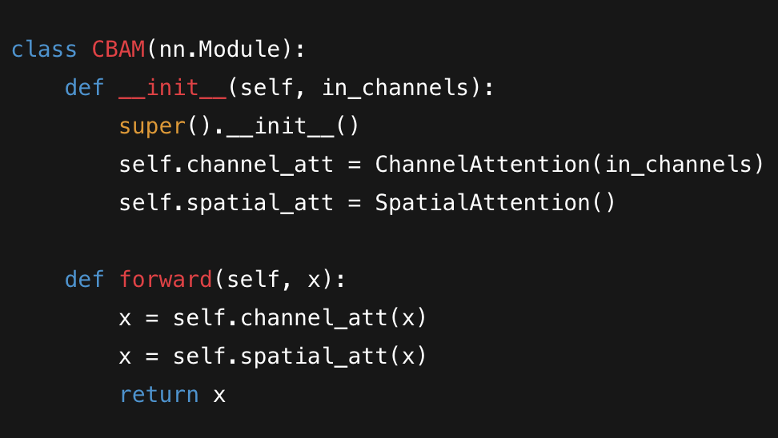
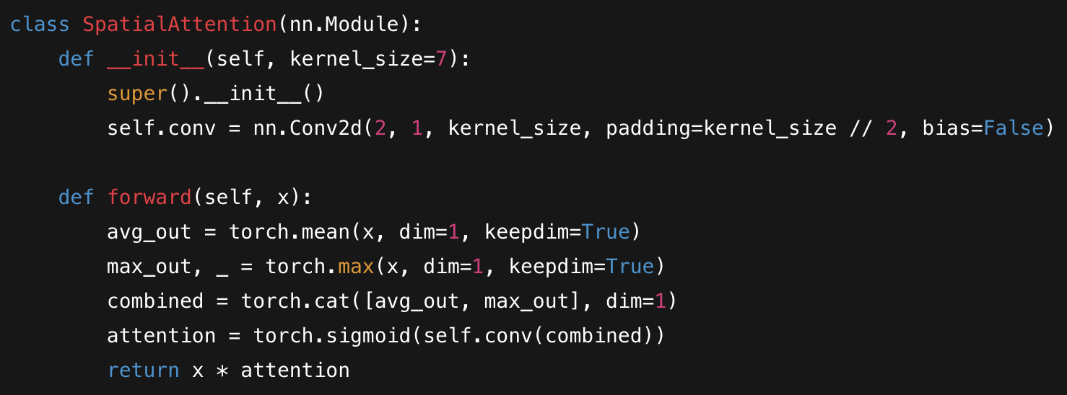

Slide 13
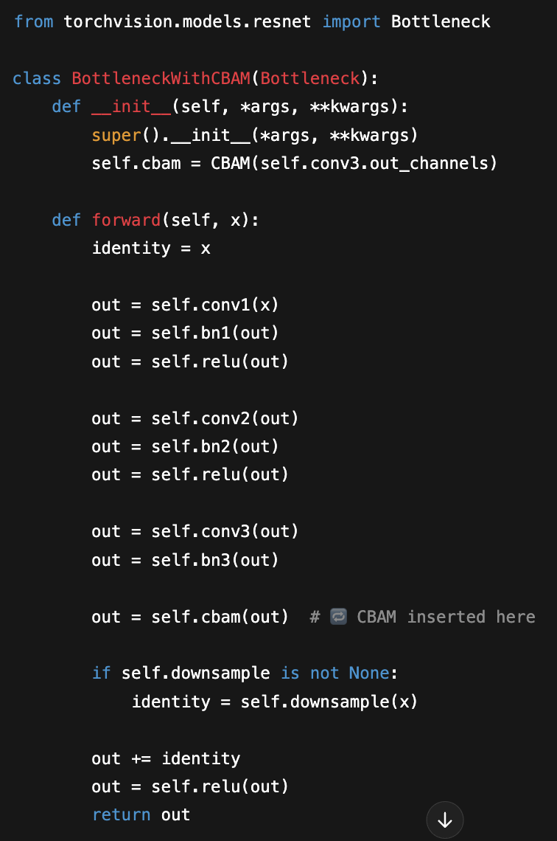
Integrate CBAM into ResNet Blocks

Slide 14
Citations
OpenAI. (2025). ChatGPT (March 27 version) [ChatGPT 4o]. https://chat.openai.com/chat
Vaswani, Ashish, et al. Attention Is All You Need. 7, arXiv, 2017. DOI.org (Datacite), https://doi.org/10.48550/ARXIV.1706.03762.
https://towardsdatascience.com/the-annotated-resnet-50-a6c536034758/
Sanghyun Woo, Jongchan Park, Joon-Young Lee, In So Kweon. CBAM: Convolutional Block Attention Module, https://arxiv.org/pdf/1807.06521

Slide 15
Additional Resources
Lecture Slides
https://cs231n.stanford.edu/slides/2024/lecture_8.pdf
Papers
https://doi.org/10.48550/ARXIV.1706.03762 (Seminal paper)
https://arxiv.org/pdf/1807.06521 (CBAM Implementation)
Blog Posts
https://towardsdatascience.com/the-annotated-resnet-50-a6c536034758/

